Slide 1

Dynasty Cars Inventory Management System
CPT-200

Slide 2
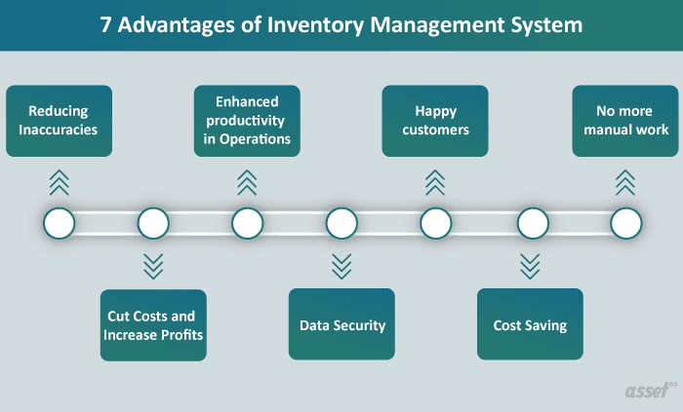
System Design Document
Put really important words here
Even more important words
You get the picture

Slide 3
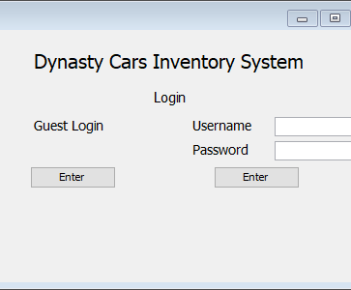
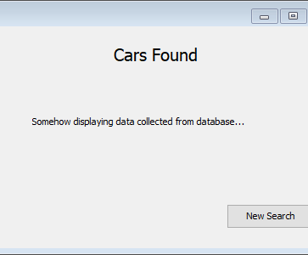
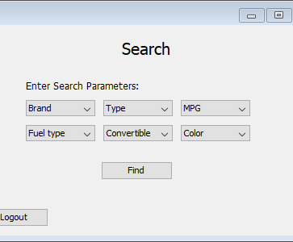
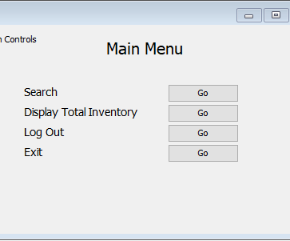
First Draft of GUI
The guest search function will allow them to add up to six characteristics they are looking for.
The admin login will present the user with more options such as Display Total Inventory.
Guests will be able to login and search without entering any data while Admins will need to submit their username and password.
This page will display data based upon what was entered on the search page. It will pull from our data base and present cars that match specifications.

Slide 4
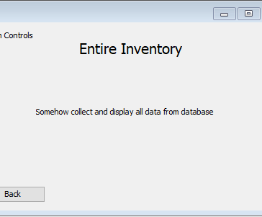
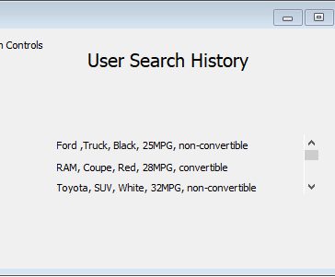
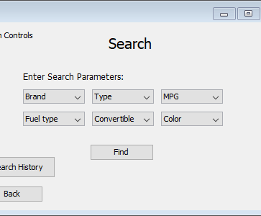
First Draft of GUI (cont’d)
Being an admin will give you an extra option in the search page which allows you to view the search history of all users.
Overall, the admins will have multiple abilites that allow them to gather more advanced data on what customers want.
This will allow an admin to browse the entire database via a scrolling menu once we have the database interacting with the program.
The User Search History page will display all past searchs in order of latest to earliest.
Guest will be able to search for the car lot without the hassle of having to create a login and password.

Slide 5
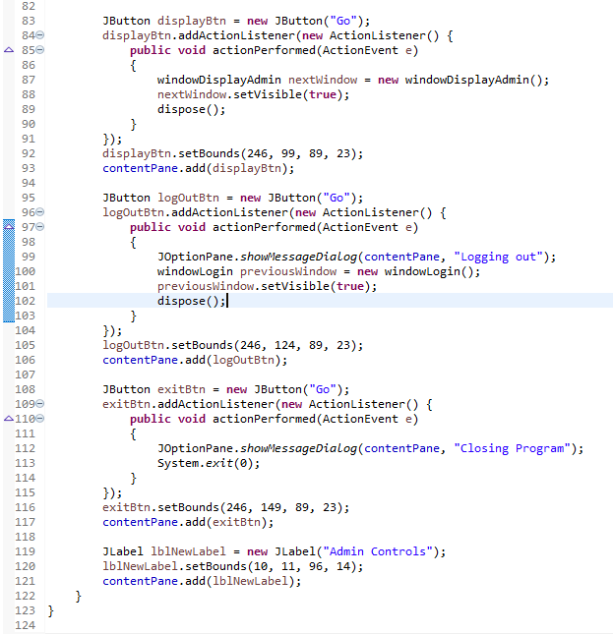
How it's built
Tools
Performance
Swing
SWT
Window Builder
Absolute layout, JLabel, JTextfield, JPasswordfield, Jbutton
Uses "JFrames" for each popup and window
Allows utilization of commands like .setVisible and dispose(); to go traverse the program
Using these commands saves resources by destroying any frames that are not currently being used

Slide 6




Roles and Responsibilities
Leo Parker
Heather Ryan
Jason Murley
Amanda Fritz
GUI setup and coding
Manage GitHub, PPT presentation, final submittal of all documentation
Put something here
UML Diagram, Database Cleanup, and Coding

Slide 7
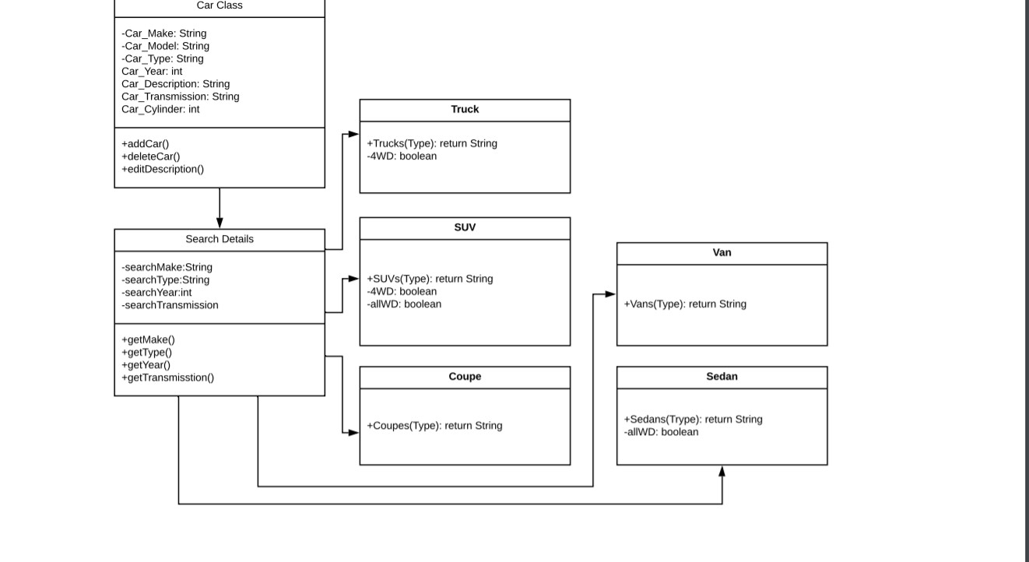
Slide 27

